Slide 1

ECE 2700
Digital Circuits
Sequential Circuits
& Latches
Copyright © 2010 Frank Vahid
Instructors of courses requiring Vahid's Digital Design textbook (published by John Wiley and Sons) have permission to modify and use these slides for customary course-related activities, subject to keeping this copyright notice in place and unmodified. These slides may be posted as unanimated pdf versions on publicly-accessible course websites.. PowerPoint source (or pdf with animations) may not be posted to publicly-accessible websites, but may be posted for students on internal protected sites or distributed directly to students by other electronic means. Instructors may make printouts of the slides available to students for a reasonable photocopying charge, without incurring royalties. Any other use requires explicit permission. Instructors may obtain PowerPoint source or obtain special use permissions from Wiley – see http://www.ddvahid.com for information.

Slide 2
Today’s Objectives
To understand the difference between combinational and sequential circuits
To become familiar with the concept of latches

Slide 3

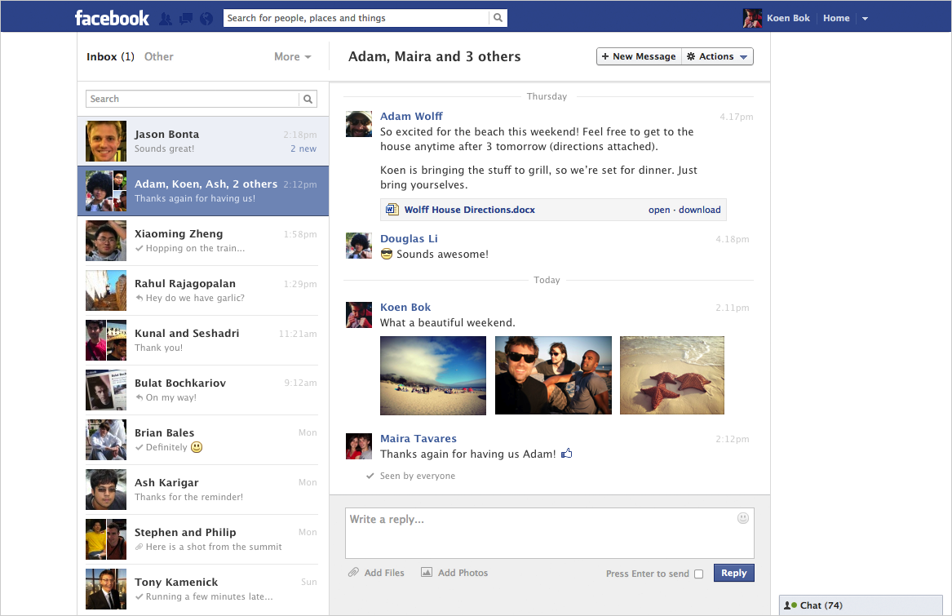
Sequential Circuits
Sometimes, we need to build circuits with memory
On/off button pressed
On/off button pressed

Slide 4
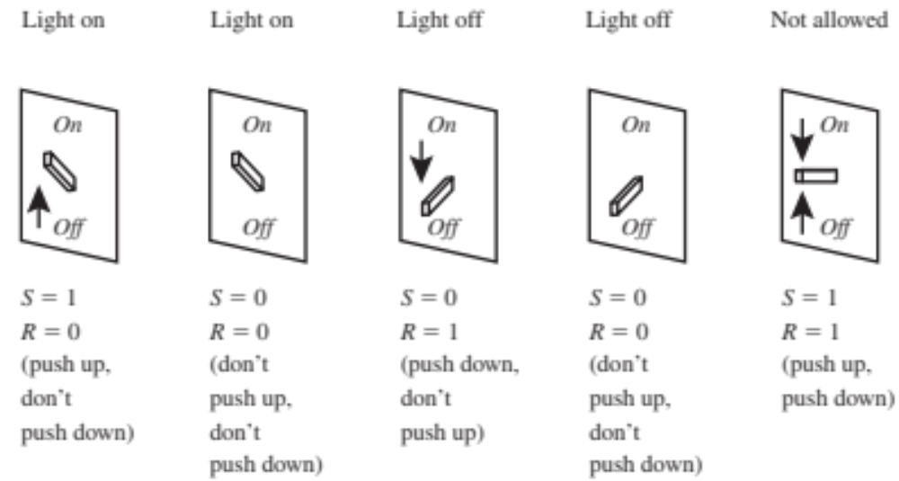
Another Example of Seq. Circuits

Slide 5
Two Types of Digital Circuits
Combinational Circuits
Sequential Circuits
Outputs solely depend on inputs
Outputs depend on
  Inputs
  System state
1
a
1
0
Combinational
digital circuit
F
b
1
a
Sequential
digital circuit
?
b
0
F
Must know sequence of past inputs to know output

Slide 6
What Do We Need To Build Seq. Circuits?
Design a new building block, a flip-flop, to store one bit
Combine flip-flops to build multi-bit storage – register
Describe sequential behavior with finite state machines
Convert a finite state machine to a controller –sequential circuit with a register and combinational logic

Slide 7
What Do We Need To Build Seq. Circuits?
Design a new building block, a flip-flop, to store one bit
Combine flip-flops to build multi-bit storage – register
Describe sequential behavior with finite state machines
Convert a finite state machine to a controller –sequential circuit with a register and combinational logic

Slide 8
Example Requiring Bit Storage
Call
button
1
Blue light
Bit
Storage
Cancel
button
1. Call button pressed – light turns on
How do we design this type of circuits?
Call
button
1
Blue light
Bit
Storage
Cancel
button
2. Call button released – light stays on
Call
button
0
Blue light
Bit
Storage
Cancel
button
3. Cancel button pressed – light turns off

Slide 9
We Need to Use Feedback
Does this work?
Call
Light
t

Slide 10
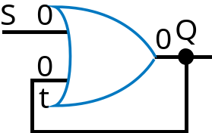


First Attempt At Bit Storage
Problem: Once Q is 1, there is no way to reset it
S
1
S
1
Q
S
1
Q
S
0
Q
0
Q
1
1
1
0
0
1
1
t
t
t
t
S
1
0
t
1
0
Q
1
0

Slide 11
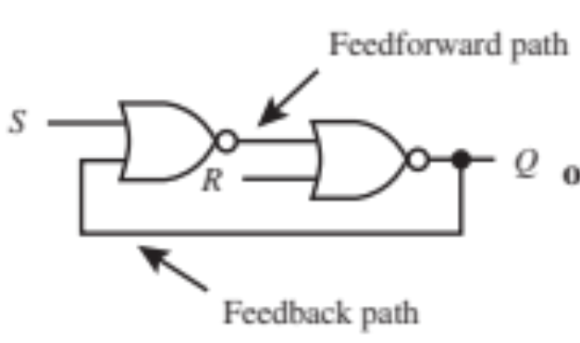
How About This One?
This is called an SR latch
S (set)
SR latch
Q
R (reset)

Slide 12

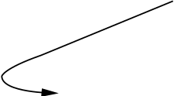
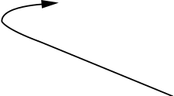
Bit Storage Using SR Latch
S (set)
SR latch
Q
R (reset)
S=0
t
S=0
t
S=1
t
S=0
t
Recall NOR…
0
1
0
1
1
0
1
0
0
0
1
1
1
0
1
0
1
1
0
0
Q
0
Q
Q
Q
X
R=1
R=0
R=0
R=0
S
1
0
R
1
0
t
1
0
Q
1
0

Slide 13

Using SR Latch
1
0
Call
S
button
Blue light
Cancel
Q
1
button
R

Slide 14
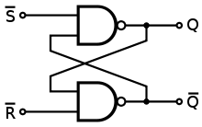
Question (AP)
What is Q when a = 0 and b = 1
  0
  1
  Undetermined
  ☹
a
b

Slide 15
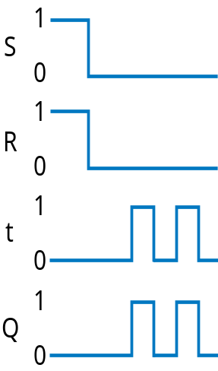
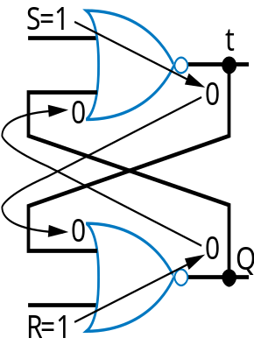
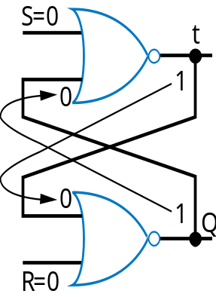
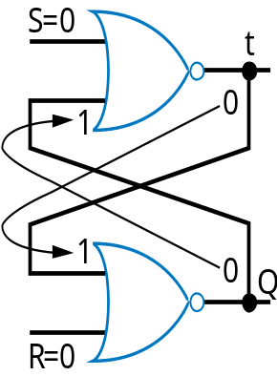
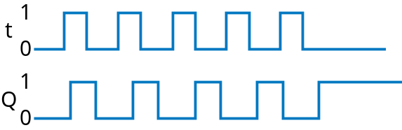
Problem with SR Latch
What if SR = 11 for a short time?
Q may oscillate. Then, because one path will be slightly longer than the other, Q will eventually settle to either 1 or 0 – but we don’t know which → race condition

Slide 16
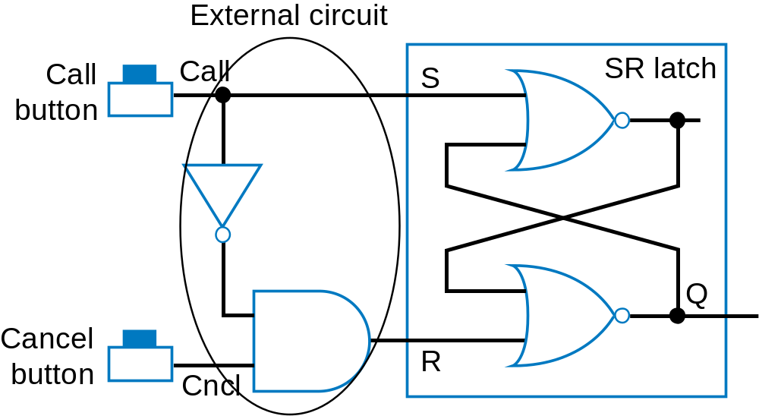
How to Avoid Race Condition in SR Latch?
What about this?
Race condition may still occur due to different path delays
  Assume 1 ns delay per gate. The longer path from Call to R than from Call to S causes SR=11 for short time – could be long enough to cause oscillation
1
Call
0
1
Cncl
0
1
S
0
SR = 11
1
R
0
2 ns

Slide 17
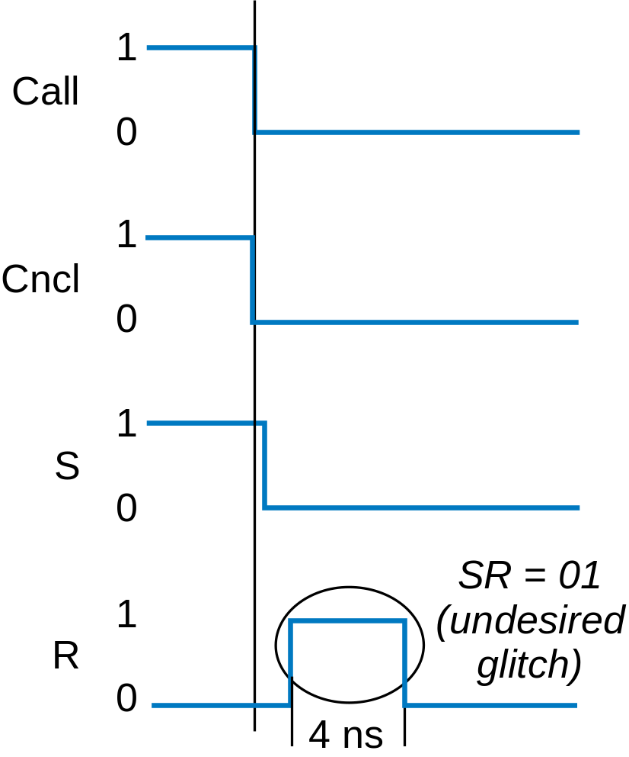
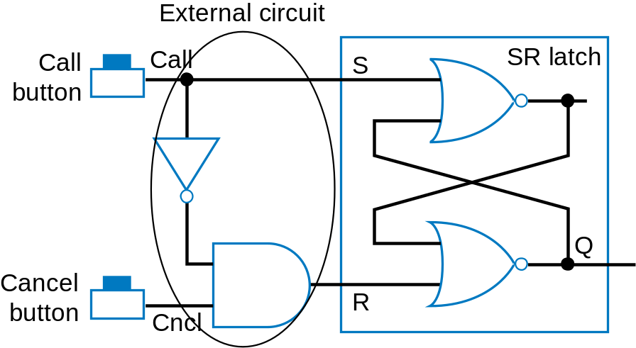
Glitch Can Also Occur
Suppose this wire has 4 ns delay
and we want SR = 10

Slide 18
SR Latch (Summary)
S | R | Q | t (same as Q’) | Note
0 | 0 | 0/1 | 1/0 | No change
0 | 1 | 0 | 1 | Reset
1 | 0 | 1 | 0 | Set
1 | 1 | ? | ? | Race condition
S (set)
t
Q
R (reset)

Slide 19
Level-Sensitive SR Latch
Add enable input “C”
When S and R change, set C = 0
Set C = 1 after S and R become stable
Avoids race conditions and glitches
Level-sensitive SR latch
S
S1
C
Q
R
R1

Slide 20
How Level-Sensitive SR Latch Works
Level-sensitive SR latch
1
S
S1
Call
Q’
0
Cncl
1
C
0
S
1
Q
0
R
1
R1
R
0
C
1
S
Q
0
C
’
1
R
Q
S1
0
Correct
values when
enabled
1
Level-sensitive SR latch symbol
R1
0
Glitch on R (or S) doesn’t affect R1 or S1

Slide 21
Level-Sensitive SR Latch Truth Table
C | S | R | S1 | R1 | Q | t | Note
0 | X | X | 0 | 0 | 0/1 | 1/0 | No change
1 | 0 | 0 | 0 | 0 | 0/1 | 1/0 | No change
1 | 0 | 1 | 0 | 1 | 0 | 1 | Reset
1 | 1 | 0 | 1 | 0 | 1 | 0 | Set
1 | 1 | 1 | 1 | 1 | ? | ? | Still problematic
Level-sensitive SR latch
S
S1
t
C
Q
R
R1

Slide 22
Latch Designs So Far
Left: SR latch
  Problems: race conditions, glitches
Right: Level-sensitive SR latch
  Problem: burden on designers to ensure SR ≠ 11 when C = 1
S (set)
t
Level-sensitive SR latch
S
S1
Q
C
R (reset)
Q
R
R1

Slide 23
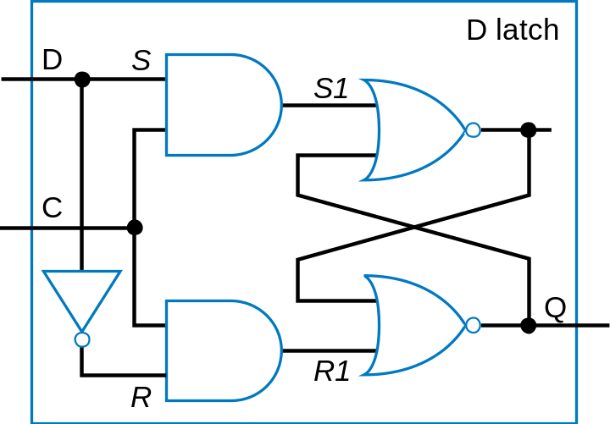
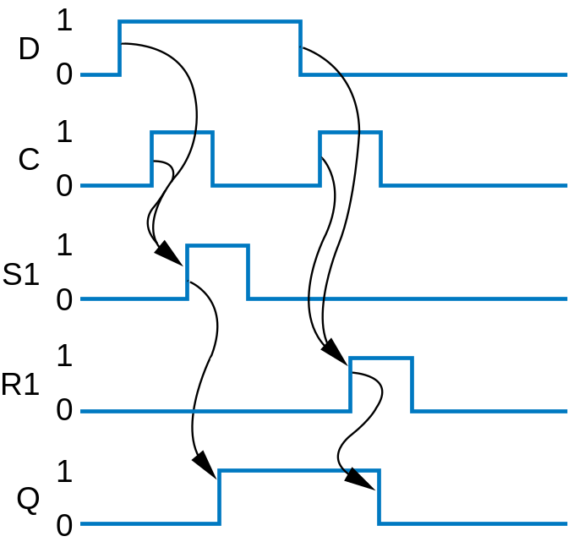
Level-Sensitive D Latch
Inserted inverter ensures R always opposite of S
D
Q
’
C
Q
D latch symbol

Slide 24
Level-Sensitive D Latch Truth Table
C | D | S1 | R1 | Q | t | Note
0 | X | 0 | 0 | 0/1 | 1/0 | No change
1 | 0 | 0 | 1 | 0 | 1 | Reset
1 | 1 | 1 | 0 | 1 | 0 | Set

Slide 25
Latches
S (set)
t
Level-sensitive SR latch
S
S1
t
Q
C
R (reset)
SR latch
Problems: race conditions, glitches
Q
R
R1
Problem: burdensome to ensure
SR ≠ 1 when C = 1

Slide 26
Today’s Objectives
To understand understand the difference between combinational and sequential circuits
To become familiar with the concept of latches

Slide 27


Question
Given the following circuit, if c = 0, what’s the value for b?
c
a
b

